Slide 1

Retrieval-Augmented Generation for Knowledge-Intensive NLP Tasks
Patrick Lewis, Ethan Perez, Aleksandra Piktus, Fabio Petroni, Vladimir Karpukhin, Naman Goyal, Heinrich Küttler, Mike Lewis, Wen-tau Yih, Tim Rocktäschel, Sebastian Riedel, Douwe Kiela
arXiv-> cs ->2005.11401
https://arxiv.org/pdf/2005.11401.pdf
Reporter : Richie Liu
Advisor : Dr. Yuan-Kai Wang
Applie Mathematics Department,
Fu Jen Catholic University
2024/05/06
Notes:
今天要和大家介紹的是這篇2020年在arxiv上的Retrieval-Augmented Generation for Knowledge-Intensive NLP Tasks.

Slide 2
Outline
Introduction
Methods
Experiments
Results
Related Work
Conclusion
Demo
Q&A
Notes:
outlien大致分為Introduction, Methods, Experiments, Results, Related Work, Conclusion, Demo, Q&A

Slide 3
Introduction
Pre-trained neural language models have been shown to learn a substantial amount of in-depth knowledge from data [41].
Their ability to access and precisely manipulate knowledge is still limited, and hence on knowledge-intensive tasks, their performance lags behind task-specific architectures.
Cons: They cannot easily expand or revise their memory, can’t straight forwardly provide insight into their predictions, and may produce “hallucinations”.
Approving LLM Performce: (i)Instruction Tuning (ii)PEFT(iii)RAG
(i) For example, few-shot, in context learning is a good approach.
(ii) LoRA which is very popular method using is GenAI.
Notes:
大語言模型已經被證明可以從數據裡面學習大量的深度知識 但是他們訪問精確知識的能力仍然有限, 表現都不如特定的架構. 缺點是不容易擴緩或是修改記憶, 還有可能產生幻覺 hallucnations. 下面幾個是讓LLM提升性能的方式: 第一個是Instructino Tuning 舉例來說就是可以給llm一些範例 有one-shot 或是few-shot等等的in-context learning的方法, 其實簡單一點就是prompt engineer再加上reinforcemnet learing from human feedback來更新mondel, 那第二個PEFT是Parameters efficent fine-tuning 大概分為很多種其中現在最多人用的是LoRa, 其實LoRA就是一個train 一個 adapter適應器, 白話一點就是train的時候多加一些layer或是去fine-tuing裡面的某幾層layer, 第三種就是今天講的rag.

Slide 4
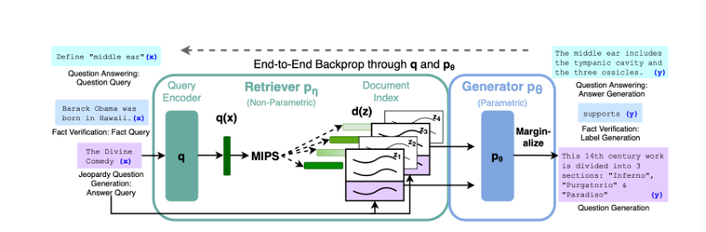
Aritechture
Non-parametric memory is a dense vector index of Wikipedia, accessed using a pre-trained neural retriever
Parametric memory is a pre-trained generative seq2seq transformer
An overview of retrieval-augmented generation (RAG). We combine a pre-trained re- triever (Query Encoder + Document Index) with a pre-trained encoder-decoder (Generator) and fine-tune end-to-end. For some query x, we use Maximum Inner Product Search (MIPS) to find the top-K most relevant documents of all documents z_{i}. To make the final prediction y, we treat z as a latent variable and marginalize over the encoder-decoder predictions given different documents.
Notes:
這一頁的aritecthtue可以看到分為兩大部分分別pre-tined retriever和pre-trained geneator兩個compent組成的, retriever就是query encoder + documenter index組合的, 那geneator 是一個 endcoder-decorder的transformer. 整個流程是輸入文字後會先通過query encoder編碼成q(x)之後在使用mips最大內積搜索算法去搜尋documente index 找到與之最相關的前K個文檔z_i, 接著再將z視為潛在變量, 在生成答案時對不同文檔的預測進行邊緣化
這個方法是將參數內存和非參數內存做結合, 參數內存是generator的部分就是在這裡是seq2seq2 transformer BART全名是bidirectional encoder representations from transformers的權重, 非參數內存是維基百科的dense vector index.
Rag和傳統的架構不同因為他是兩個pre-trained combined再一起, 可以很輕易的替換其中的組件.

Slide 5
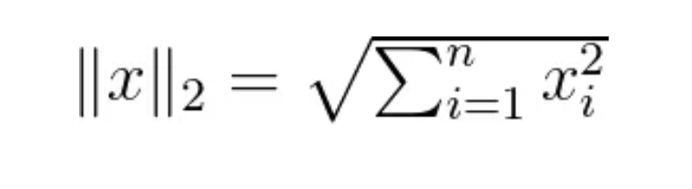
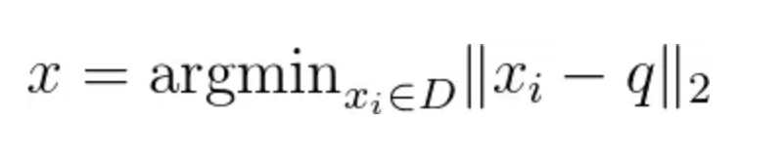
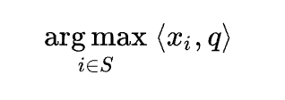
Maximum Inner Product Search(MIPS)
Usually, nearest neighbor search is phrased as a problem for vectors in Euclidean space. The norm of a vector x is defined as
Given a database D, the nearest neighbor for a query vector q is the vector x in D such that
MIPS search can be defined as the problem of determining
Assuming you have a set of d-dimensional vectors d_i forming a set D, and now you input a query vector q of the same dimension, please find a vector p from X such that the dot product of p and q is maximized within the set X. This is defined as MIPS.
Notes:
這一頁介紹一下MIPS, 全名是..., 算法就是字面意思要找...maximun inner product.
這邊先複習一下 一般而言定義Eculiedan space的距離用x的nrom來定義, 那這邊是用l2.
那給定一個數據庫D要找到一個x 在 D裡面使得x和小q的距離最小就會定義成上面的公式.
那下面就進到MIPS, 其實蠻好理解的, 問題就是找到集合S中與q內積最大的向量xi
假設你有一堆d維向量d_i，組成集合D，現在輸入了一個同樣維度的查詢向量q(query)，請從S中找出一個x_i，使得x_i和q的點積是最大的。
找最大是因為向量內積如果夾角是0那cos 0 就是最大, 也就是說夾角是0度的時候那就是兩個向量重合也就是相等

Slide 6
Method
The RAG model consists of two components: a retriever and a generator
Retriever pη(z|x): Given input x, retrieves relevant text passages z and their score distributions
Generator pθ(yi|x, z, y_{1:i-1}): Generates the current token yi based on input x, retrieved passage z, and previously generated tokens y1:i-1
During training, the retrieved document z is treated as a latent variable
Two RAG models are proposed that marginalize over the latent documents z in different ways
(i) RAG-Sequence: Uses the same document z to predict all target tokens
(ii) RAG-Token: Can predict each target token based on different documents z
Notes:
這一頁就是講到RAG是retriever和generator組合的 retriever p intea (z|x)是給定一個input seqence x 來檢索document z的文本片段.
Geneartor是根據前i一個stemp產出的token y_{1:i-1} 與給定的x和檢索到的z做combined再去算y_i
在訓練期間z被視為一個淺在變量
第五點是論文提出了兩種RAG模型，它們以不同的方式對潛在文檔z進行邊際化處理 1. RAG-Sequence
該模型使用同一份文檔z來預測每個目標token
2. RAG-Token
該模型可以基於不同的文檔z來預測每個目標token

Slide 7
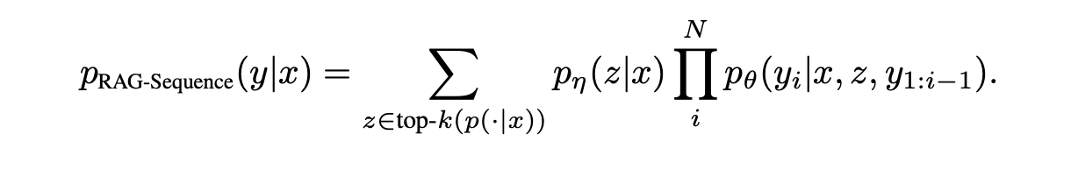
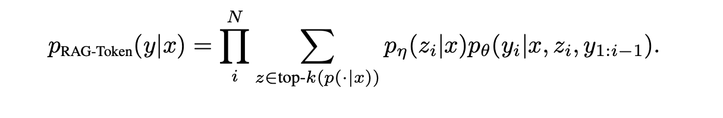
Models
In LLMs, if we want to compute y = (y1, y2, ..., yN), P(y|x). According to the chain rule we can define:
P(y|x) = P(y1|x) * P(y2|x, y1) * P(y3|x, y1, y2) * ... * P(yN|x, y1, ..., yN-1)
RAG-Sequence:
RAG-Token:
Notes:
這一頁就是把raq-seq和rag-tok寫成數學式, 我們recap一下在語言模型中,我們想計算一個序列 y = (y1, y2, ..., yN) 的條件概率 P(y|x)。根據鏈式法則,我們可以將它分解為:
P(y|x) = P(y1|x) * P(y2|x, y1) * P(y3|x, y1, y2) * ... * P(yN|x, y1, ..., yN-1)
那rag seq這個數學公式就好理解了, 最後面的P_theta這一部分就是geneartor相乘, 因為我們是給定前n個token去計算, 左邊p_inta就是retriever的部分最後再取sum就可以得到檢索到該文檔的概率
rag token是因為要考慮k個文檔所以先取sum在乘積
最後就是論文提到如果序列長度唯一, 兩者是等價

Slide 8

Retriever: Dense Passage Retriever (DPR)
The retrieval component pη(z|x) is based on DPR [22]. DPR follows a bi-encoder architecture:
d(z) is a dense representation of the document produced
q(x) a representation of the query
To efficiently calculate top-k(pη(·|x)), the list of k elements z with highest prior probability pη(z|x), DPR employs a Maximum Inner Product Search (MIPS) index provided by the FAISS library [19].
We use a pre-trained bi-encoder from [22] to both initialize our retriever and to build the document index. This retriever was trained to retrieve documents which contain answers to TriviaQA [20] questions and Natural Questions [25].
Notes:
這一頁是講到retriever的部分, 這邊是用DPR這個架構retrieval p ineta (z|x)是從22這篇論文來的, 裡面說到DPR是一個雙encoder的架構 對於每個文檔 z 和查詢 x,DPR 分別用兩個不同參數的模型去得到它們的密集表示 d(z) 和 q(x). 數學式就是上面這個
這邊的密集指的是說向量, 相反的如果是one-hot encoder得到的就會是sparse的向量.
那接下來就是用mipse去計算 d(z) 和 q(x)的值, 最後再過一個 softmax 函數轉換為條件概率 p(z|x)
然後論文是說用 FAISS 這個library來實作 Maximum Inner Product Search (MIPS). 作者使用了一個預訓練的 DPR 雙編碼器模型來初始化參數, 並構建文檔索引庫。
這個預訓練模型是用TriviaQA 和 NaturalQuestions這兩個數據集做訓練的

Slide 9
Generator: BART
We use BART-large [28], a pre-trained seq2seq transformer [52] with 400M parameters.
To combine the input x with the retrieved content z when generating from BART, we simply concatenate them.
BART was pre-trained using a denoising objective and a variety of different noising functions. It has obtained state-of-the-art results on a diverse set of generation tasks and outperforms comparably-sized T5 models [28].
We refer to the BART generator parameters θ as the parametric memory henceforth.
Notes:
在RAG模型中,作者選擇使用BART-large作為Generator,它是一個大型的預訓練seq2seq transformer模型,參數量達4億。
為了將輸入查詢x和檢索文檔z輸入到BART中生成,作者採取了一種簡單的拼接(concatenate).
選擇BART作為Generator的選擇,是因為它使用了一種去噪自編碼(denoising autoencoder)的方式進行預訓練, 表現在許多生成任務上都超過了同等大小的T5模型, T5是谷歌開發的另一個text to text transformer.
BART模型的參數θ稱為參數記憶因為它實際上就是通過訓練獲得的參數,用於將x和z編碼並生成輸出y。

Slide 10
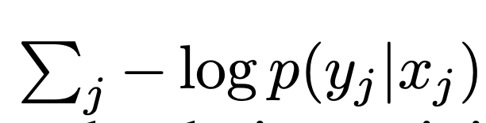
Training
Given a fine-tuning training corpus of input/output pairs (x_j , y_j ), we minimize the negative marginal log-likelihood.
Using stochastic gradient descent with Adam.
Updating the document encoder during training is costly as it requires the document index to be periodically updated as REALM does during pre-training [18].
We do not find this step necessary for strong performance, and we keep the document encoder (and index) fixed, only fine-tuning the query encoder and the generator.
Notes:
作者是給定一組input/output(xj, yj) 去做fine-tuning ,目標是最小化目標yj的負邊際對數似然(negative marginal log-likelihood)。
訓練時, 只更新查詢編碼器(query encoder) intea和genator theta的參數
使用隨機梯度下降和Adam優化算法進行參數更新。
adam是montiu+rmsprop
作者指出,在fine-tuning過程中更新document encoder和index會像REALM(Retrieval-Augmented Language Model Pre-Training)這篇論文一樣很花錢, 並且認為這一步對模型的表現影響不大, 所以他沒有update.

Slide 11
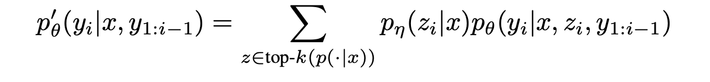
Decoding
At test/decoding time, RAG-Sequence and RAG-Token require different ways to approximate arg maxy p(y|x).
RAG-Token: The RAG-Token model can be seen as a standard, autoregressive, seq2seq generator with transition probability:
To decode, we can plug p′θ(yi|x,y1:i−1) into a standard beam decoder.
RAG-Sequence: We run beam search for each candidate document z, scoring each hypothesis using pθ(yi|x, z, y1:i−1). This yields a set of hypotheses Y of which some might not have appeared in the beams of all documents.
For longer output sequences, |Y | can become large, requiring many forward passes. For more efficient decoding, we can make a further approximation that pθ(y|x,zi) ≈ 0 where y was not generated during beam search from x,zi. This avoids the need to run additional forward passes once the candidate set Y has been generated. We refer to this decoding procedure as “Fast Decoding”.
Notes:
rag token 和rag model要用不同的方法decode
rag token是長上面這樣, 可以用一種叫做beam search的方法來deocde簡單還說就是一種greedy alothrim 只是有考慮time stemp
rag seq則是要對每一個文檔z都去算, 最後會得到一個假設的集合Y再從裡面去選
那作者說要得到這個Y需要考慮需要考慮文檔的缺失, 因為是在多個文檔做選擇, 就會有問題, 那這樣就要再做一些其他計算,
總之就是作者提出一種辦法叫做”Fast Decoding”讓這個過程更快.

Slide 12
Experiments
We use a single Wikipedia dump for our non-parametric knowledge source.
Each Wikipedia article is split into disjoint 100-word chunks, to make a total of 21,015,324 documents.
We use the DPR document encoder to compute document embeddings for each document, and we build a single MIPS index using FAISS [19] using Hierarchical Navigable Small World approximation for efficient retrieval [33]
During training, we retrieve the top k documents for each query, where we consider k ∈ {5, 10}.
We determine k for test time using validation data. In the remainder of this section, we will discuss the experimental details for each of these task settings.
Notes:
1.使用Wikipedia的資料庫作為非參數知識源。
2. 將每篇Wikipedia文章切分成長度為100個詞的獨立文檔塊(chunks),總共產生了2101萬多個文檔。
3. 使用DPR (Dense Passage Retriever)文檔編碼器計算每個文檔的embedding, 利用FAISS庫中的HNSW(Hierarchical Navigable Small World)近似算法建立了一個MIPS(Maximum Inner Product Search)索引, 用於高效檢索相關文檔。
4. 在訓練過程中,會為每個查詢檢索top k (k=5或10)個最相關文檔,k的值在驗證集上調整選擇。
5. 實驗部分將根據不同任務設置,分別討論訓練和評估的細節。

Slide 13
Open-domain Question Answering
Open-domain Question Answering (QA) is a critical real-world NLP application for testing knowledge-intensive tasks. It treats questions and answers as simple text pairs and minimizes the negative log-likelihood of answers.
Four open-domain QA datasets were used: Natural Questions (NQ), TriviaQA (TQA), WebQuestions (WQ), and CuratedTrec (CT). CuratedTrec's regex-based answers required a pre-processing step to match the most frequent answers from the top 1000 documents or generate permutations for unmatched cases.
The RAG models for CuratedTrec and WebQuestions were initialized using the Natural Questions RAG model due to their smaller dataset size.
For TriviaQA, an additional test on the Wiki test set was performed for comparison with T5.
Notes:
開放領域問答是一項重要的實際NLP應用,常被用來測試知識密集型任務的性能, 方法是將問題和答案視為簡單的輸入輸出文本對(x, y),通過最小化答案的負對數似然來訓練RAG模型。
實驗數據集包括4個流行的開放領域問答數據集:NQ、TQA、WQ和CT, 對於CT數據集, 作者進行了預處理讓他可以match top 1000篇相關文檔, 或是對不match的做一些選擇.
CT和WQ這兩個數據及比較小,作者透過NQ的RAG來初始化。
我們對TriviaQA Wiki測試集進行了額外的測試評估。

Slide 14
Abstractive Question Answering
The MS-MARCO Natural Language Generation task v2.1 is utilized to assess RAG's capability in producing natural language responses within a knowledge-demanding context. This task involves processing natural language queries inputted into a search engine, along with ten snippets retrieved per query, and generating a complete sentence as an answer based on these snippets.
In evaluating RAG, only the questions and answers are used without the retrieved snippets, framing MS-MARCO as an open-domain abstractive QA task. This approach acknowledges that some questions, such as those requiring specific contextual knowledge (e.g., "What is the weather in Volcano, CA?"), may not be as accurately answered due to the absence of direct context, potentially lowering performance compared to models using provided passages.
Additionally, it's noted that certain MS-MARCO queries cannot be satisfactorily answered using Wikipedia alone. For these instances, RAG leverages the implicit knowledge embedded within its BART parameters to formulate answers based on commonsense reasoning.
Notes:
RAG結合了編碼器-解碼器模型，不僅僅限於抽取式問答，還能用自由形式的抽象文本生成來回答問題。
為了測試RAG在知識密集型設定中生成自然語言回應的能力，研究者們使用了MS-MARCO自然語言生成任務v2.1。
這個任務包括對搜索引擎提交的自然語言問題、每個問題檢索到的十個摘要片段，以及從這些片段中標註出的完整句子形式的自然語言答案。
作者指出，MS-MARCO包含了一些問題，如果沒有訪問到相關的文本片段，就無法生成與參考答案匹配的答案，例如問題“加州火山鎮的天氣怎麼樣？”。因此，開放域MS-MARCO的表現會低於其他模型。
此外，作者還提到MS-MARCO中有一些問題僅憑維基百科知識來源是無法回答的。在這些情況下，RAG可以依賴其BART參數中的參數隱含知識，來生成常識性的回答。

Slide 15
Jeopardy Question Generation
To assess RAG's capabilities beyond question answering, an open-domain question generation task is proposed, focusing on generating Jeopardy-style questions. Unlike standard QA[10] tasks, Jeopardy questions involve guessing an entity based on a fact about that entity, making it a more challenging and knowledge-intensive task.
The dataset comprises raw Jeopardy data from SearchQA, with 97,391 training, 13,713 development, and 26,848 test data points. A BART system is also trained for comparative analysis.
Evaluation employs the SQuAD-tuned Q-BLEU-1[37] metric, which is more aligned with human judgment for question generation by emphasizing entity matches.
Due to the unreliability of automatic metrics for open-ended tasks, human evaluations are conducted to assess the factuality and specificity of the generated questions. A pairwise comparison between BART and RAG-generated questions is performed, where assessors choose the better question or if both/neither are satisfactory.
Notes:
這部分介紹了為進一步評估RAG在非問答場景下的生成能力,作者提出了一種open-domain問題生成任務，專注於生成危險邊緣（Jeopardy）風格的問題。 Jeopardy問題涉及根據實體的事實來猜測該實體，例如，當給出“1986年墨西哥成為首個兩次主辦這項國際體育賽事的國家”時，答案就是“世界盃”。
數據集包括來自SearchQA的原始Jeopardy數據，包含97,391個訓練數據點、13,713個開發數據點和26,848個測試數據點。同時訓練了一個BART系統進行比較分析。
評估使用了為SQuAD調整過的Q-BLEU-1指標，blue好像是一種考慮n-gram的生成分數的一種指標, 這個指標通過強調實體匹配，更加符合人類對問題生成的判斷。
作者也提到由於自動指標對於開放式任務的不可靠性，進行了人類評估來評估生成問題的事實性和具體性。執行了BART和RAG生成問題之間的成對比較評估，
評估員選擇較好的問題或者判定兩者/均不合適。

Slide 16
Fact Verification
FEVER [50] is a fact verification dataset that involves classifying whether a natural language claim is supported or refuted by Wikipedia, or whether there is not enough information to decide.
It also provides a good test bed for exploring the RAG models’ ability to handle classification rather than generation.
We map FEVER class labels (supports, refutes, or not enough info) to single output tokens and directly train with claim-class pairs.
Unlike most other approaches to FEVER, we do not use supervision on retrieved evidence. We explore two different FEVER variants: the standard 3-way classification task (supports/refutes/not enough info) and the 2-way FEVER (supports/refutes) task studied in Thorne and Vlachos [51].
Notes:
FEVER是一個事實驗證任務, 用於分類自然語言claim是支持, 反對, 或是不夠訊息的情況
主要是在講說是從wiki上面檢索和聲明相關的證據然後再用檢索到證據做推理, 所以是一個非常適合RAG的測試, 因為要檢索訊息和推理
在這個研究中，我們將FEVER的類別標籤（支持、反駁或沒有足夠信息）映射到single output token，並直接使用claim-class對進行訓練。
與大多數其他處理FEVER的方法不同，我們不使用檢索到的證據上的監督學習。我們探索了FEVER的兩種不同變體：標準的3種分類任務（支持/反駁/沒有足夠信息）和Thorne和Vlachos研究的2種分類FEVER任務（支持/反駁）。

Slide 17
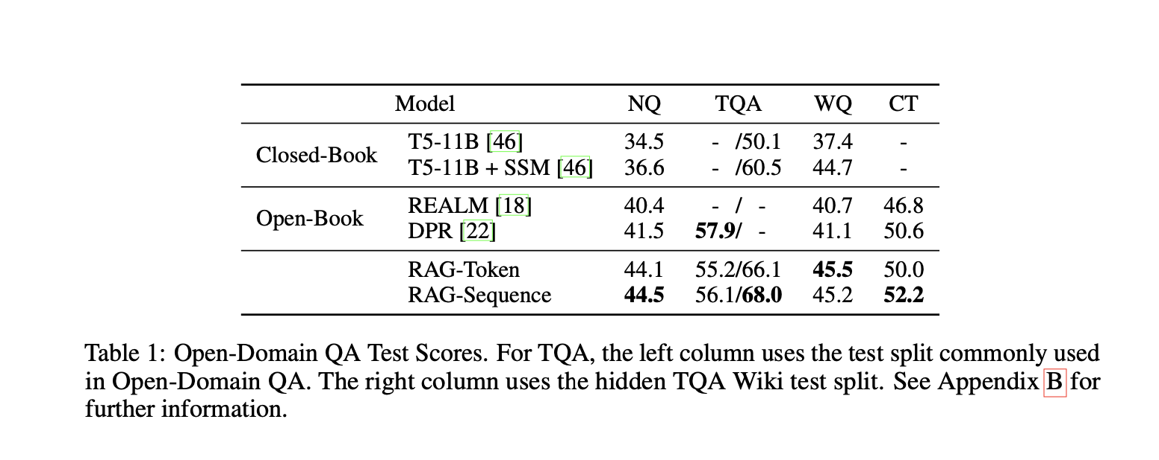
Results
Table 1 shows results for RAG along with recent state-of-the-art models. On all four open-domain QA tasks, RAG sets a new state-of-the-art
Notes:
這邊就是講到結果
我們可以先到左邊有closed-book和open-nook兩種方法, Closed-book模型是依賴於模型內部的知識來回答問題，不會檢索外部信息，類似於我們熟悉的高中的考試模式。
而Open-book模型在回答問題時會檢索和使用外部信息源，就像潘老師的考試.
上面的T5是谷歌研發的text2text transformer ssm是sparse search module一種搜尋的模塊
REALM（Retrieval-Augmented Language Model）是谷歌研發的结合了訊息檢索功能的語言模型
作者還有提到與REALM和T5+SSM不同，RAG不需要昂貴的專門的“salient span masking”預訓練[18], 就可以靠現成的組件獲得較強的成果。
數據顯示各項指標都不錯

Slide 18
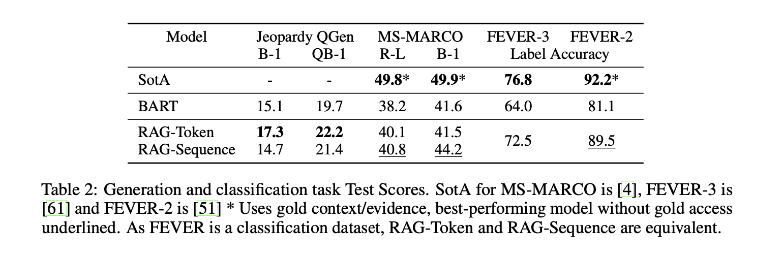
Results
Notes:
RAG-Sequence在這些datasets的Bleu和Rouge-L兩個評估指標上都比BART模型高出2.6分。這表示RAG-Sequence在這項任務上的表現更好。
包含剛剛介紹的Jeopardy和抽象數據ms-marco以及FEVER這幾個dataset都是超過BART.

Slide 19
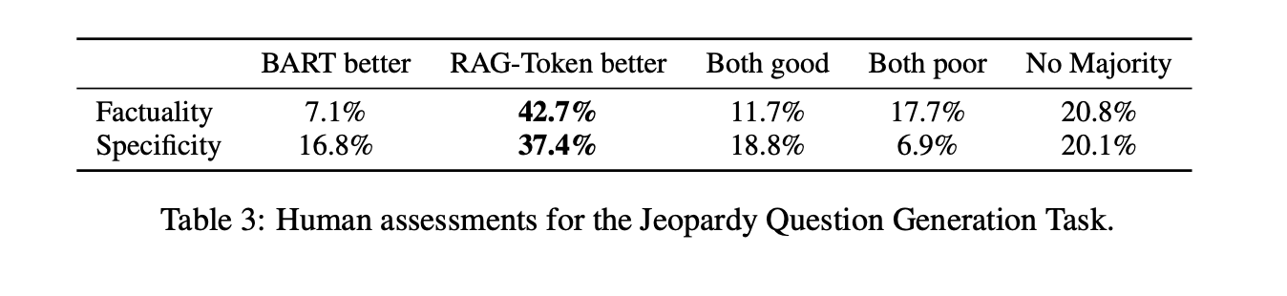
Results
Notes:
表3顯示了人工評估的結果。分別對BART和RAG-Token的進行了人為評分

Slide 20
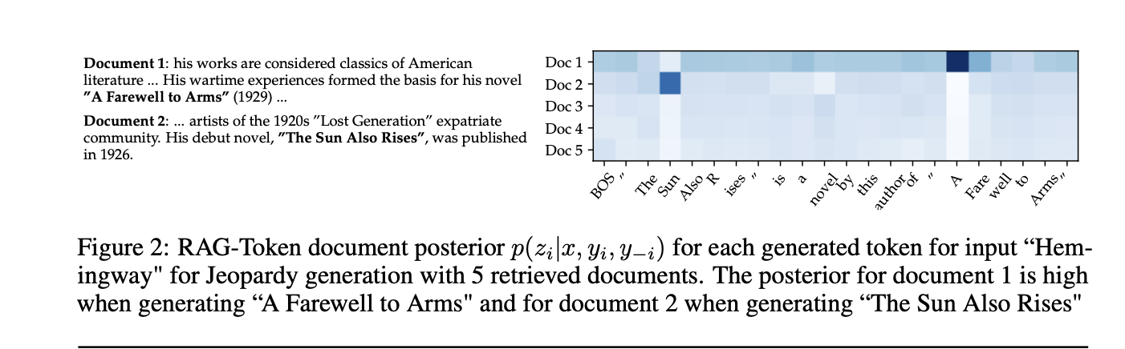
Results
We show evidence for the above interpretation by feeding the BART-only baseline with the partial decoding "The Sun. BART completes the generation "The Sun Also Rises" is a novel by this author of "The Sun Also Rises" indicating the title "The Sun Also Rises" is stored in BART’s parameters.
Notes:
這邊是為危險邊緣的結果, 我們先看圖片作者假設RAG-Token在這項任務上表現最佳，因為《危險邊緣》風格的問題往往包含兩個關於實體的獨立信息片段，而RAG-Token能夠通過合併兩個檢索到的文檔來做回答。
第一份是海明威的《永別了，武器》這個裡面的A Farewell to arms 第二份文檔包含了關於海明威的《太陽照常升起》的The Sun Also Rises
下面的數學式就是之前講過的, 那結果就是說在這些書名的第一個詞被生成後，對文檔的分布又再次變得平坦，之後又檢索到第一份文檔的內容, 所以實驗證明了model可以根據問題的內容動態的去選擇最有關係的文章.
這邊還有設計一個BART來做對照, 就是上面這塊
他們給BART模型提供了the sum 然後bert就完成了the sun also rises, 就可以證明說這些知識是有被存在bert的參數裡面

Slide 21
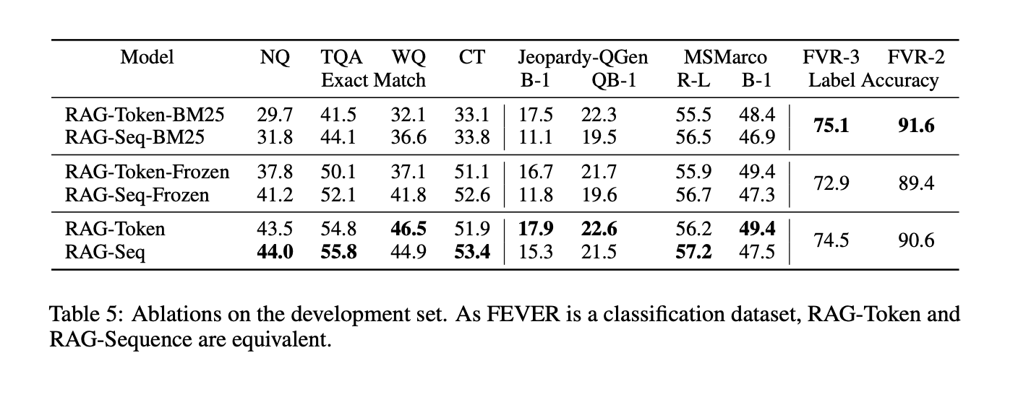
Results
Notes:
爲了更好地理解影響RAG性能的因素，我們在各自的開發集中對我們的任務執行了很多Ablations消融實驗。
消融研究是一種用於理解機器學習模型各個部件如何影響模型整體性能的方法。通過在模型中去除某些部件或功能去觀察這個改變對模型的影響.
圖3(中間)顯示，RagToken 和Rag seq都表現得很好。
TriviaQA和Natural Questions的改進是顯著的，因爲我們從DPR初始化檢索器。
對於FEVER，我們發現BM25表現最好，BM25是一種算法是用來計算搜索詞和文檔的相關性的一個分數, 有一點相tf-idf, 作者猜這個model會比較好可能是因為claim的方式所以非常適合基於單詞重疊的檢索。

Slide 22
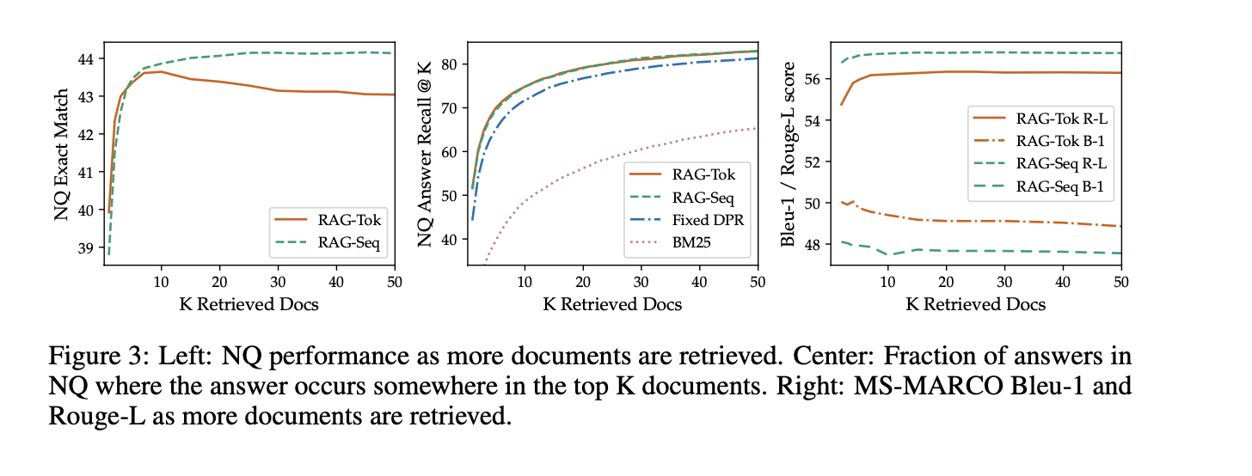
Results
Notes:
這邊是在探討topk的實驗 RAG模型在訓練時會使用5個或10個檢索到的潛在文檔，但這兩種情況下就是第一個圖, 模型的表現並沒有顯著差異。
在測試時改變檢索文檔的數量對性能有影響，對於RAG-Sequence模型，檢索更多文檔會使性能提高；然而對於RAG-Token模型，在檢索了10個文檔後性能達到峰值。
從最右圖可以看出，檢索更多文檔會提升RAG-Token在Rouge-L上的分數，但同時會降低Bleu-1。這種影響在RAG-Sequence上則不那麼明顯。

Slide 23
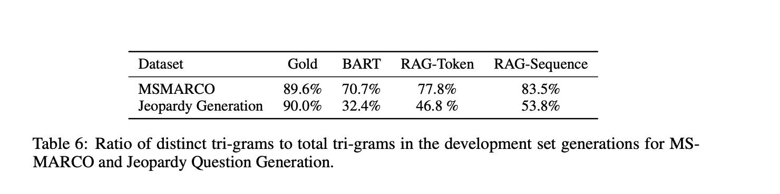
Generation Diversity
Notes:
這邊是作者在研究多樣性, 通過計算不同模型生成的不同ngram與總ngram的比率來研究代的多樣性。 那rag model在Jeopard和MSMARCO是Abstractive Question Answering這兩個datasets上面表現都比BART好，他們也發現RAG-Sequence比RAG-Token代更多樣化

Slide 24
Related Work
Single-Task Retrieval Prior work has shown that retrieval improves performance across a variety of NLP tasks when considered in isolation. Such tasks include open-domain question answering [5, 25], fact checking [50], fact completion [42], long-form question answering [12], Wikipedia article generation [32], dialogue [36, 59, 9, 13], translation [16], and language modeling [17, 23]. Our work unifies previous successes in incorporating retrieval into individual tasks, showing that a single retrieval-based architecture is capable of achieving strong performance across several tasks.
Notes:
好接下來講到related work 第一個是Single-Task retrieval 這個retrieval已經被證明可以提高NLP tasks的性能
像是開放域問答[5,25]、事實檢查[50]、事實補全[42],
長篇問答[12]、維基百科文章生成[32]、對話[36,59,9,13]、翻譯[16]和語言建模[17,23]。 作者的工作就是將這些retrieval結合起來，實現更多跨功能的表現。

Slide 25
General-Purpose Architectures for NLP
Pre-trained language model has been shown to achieve strong performance on various classification tasks in the GLUE bench- marks [54, 55] after fine-tuning [43, 8].
GPT-2 [44] later showed that a single, left-to-right, pre-trained language model could achieve strong performance across both discriminative and generative tasks.
BART [28] and T5 [45, 46] propose a single, pre-trained encoder-decoder model that leverages bi-directional attention to achieve stronger performance on discriminative and generative tasks.
Our work aims to expand the space of possible tasks with a single, unified architecture, by learning a retrieval module to augment pre-trained, generative language models.
Learned Retrieval
Memory-based Architectures
Notes:
第二個是General-Purpose Architectures for NLP已有研究表明，單一的預訓練語言模型在微調後，能在GLUE基準測試中的多項分類任務上達到強大的表現。
這邊像是GPT-2證明了這種模型在包括辨別型（discriminative）和生成型（generative）任務上都能取得強大的性能。
BART和T5這兩種模型提出了pre-trained encoder-decoder架構，通過利用雙向注意力（bi-directional attention）機制，能在辨別型和生成型任務上達到更強的表現。
作者的工作就是想辦法增強pre-trained的語言模型，從而擴大具有單一統一架構的可能任務的空間。

Slide 26
Conclusion
The RAG (Retrieval-Augmented Generation) paper introduces an innovative machine learning framework that combines retrieval and generation models to enhance information retrieval and content creation in natural language processing tasks, aiming to provide more accurate and richer responses.
Notes:
RAG(檢索-增強生成)論文介紹了一種創新的機器學習框架，該框架結合了檢索和生成模型，以增強自然語言處理任務中的信息檢索和內容創建，旨在提供更準確和更豐富的響應。
白話來就是大家在考潘老師的考試的時候, 可以帶小抄, 那「小抄」的整理，其實就是 RAG 過程，我們整理knowledge base的資訊成一張小抄, 那這張紙就是Embedding Vector DB,
之後我們考試的時候就是檢索器和生成器, 我們檢索到答案後在生成出我們自己的答案.

Slide 27
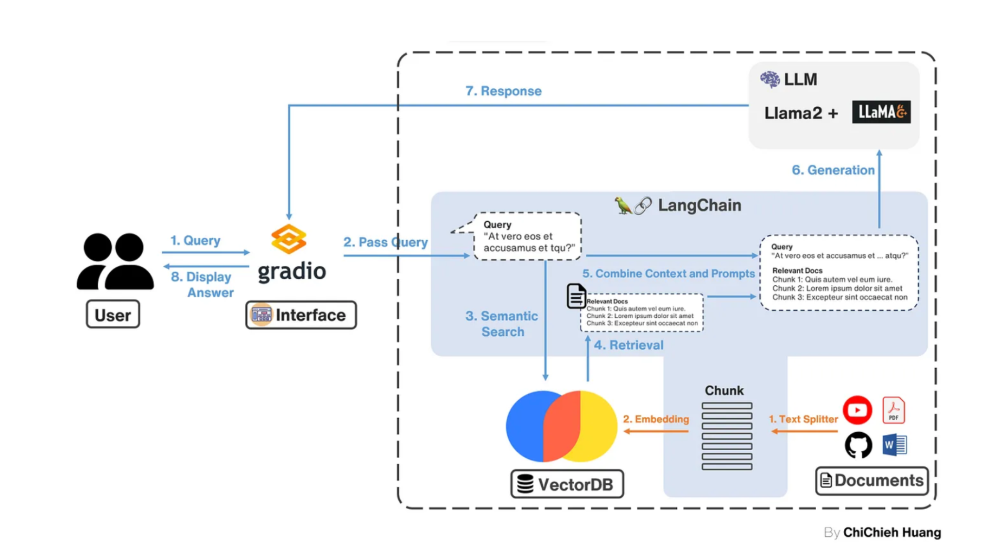
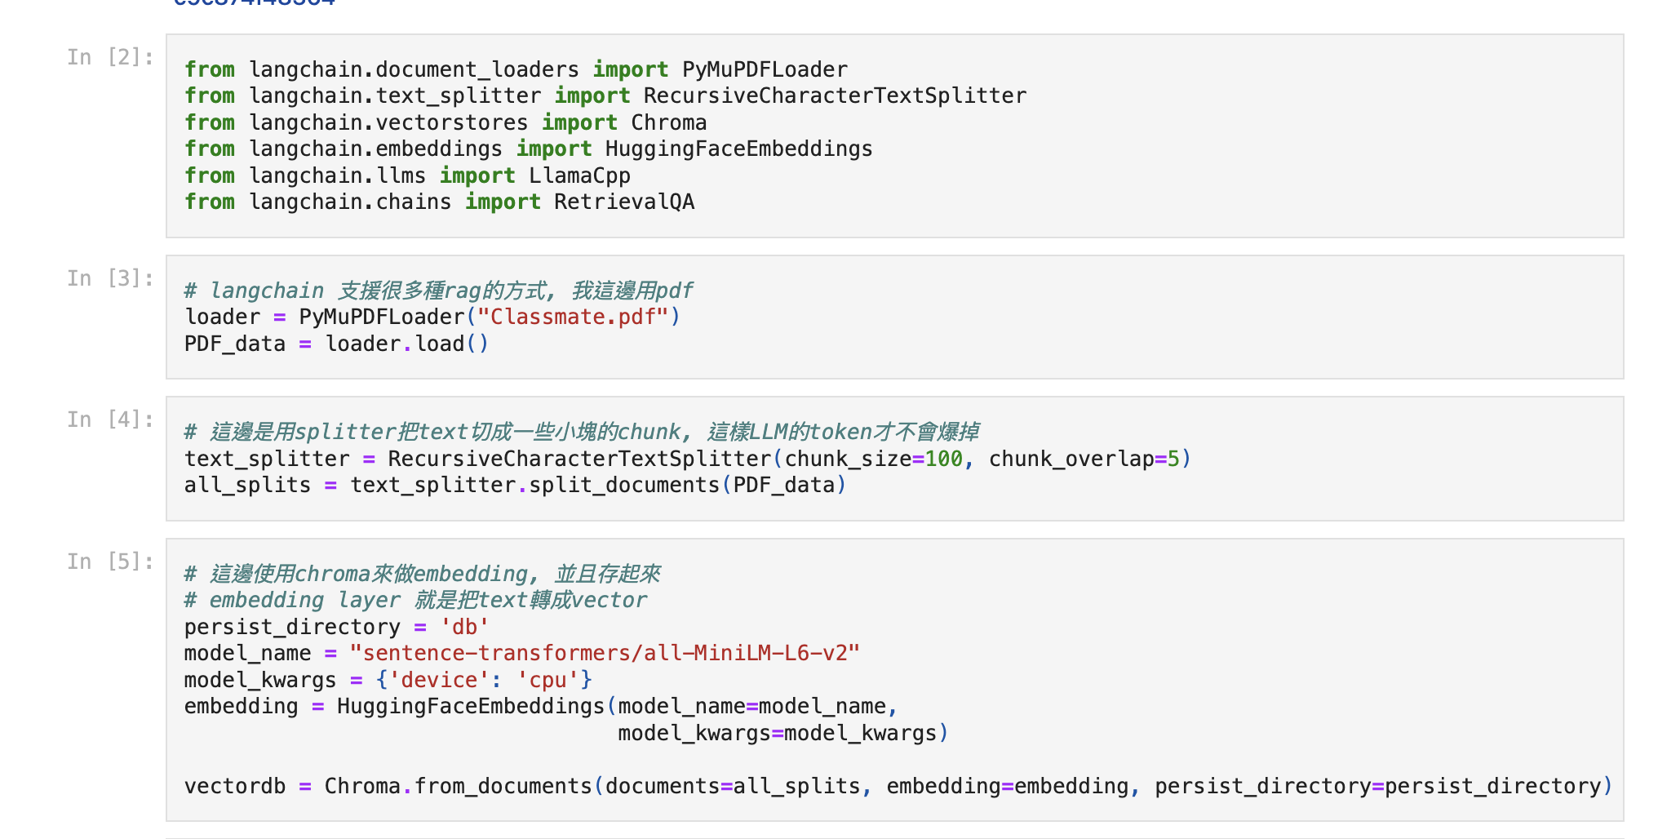
Demo
Notes:
左邊是架構圖, 我是用langchian這個開發工具來構建這個chatbot, user下指令之後LLM會去vectorDB裡面撈資料在回答我, 程式碼我先給一個pdf, 之後切分文檔成100個chunk, 在做embedding 存成vector db,

Slide 28
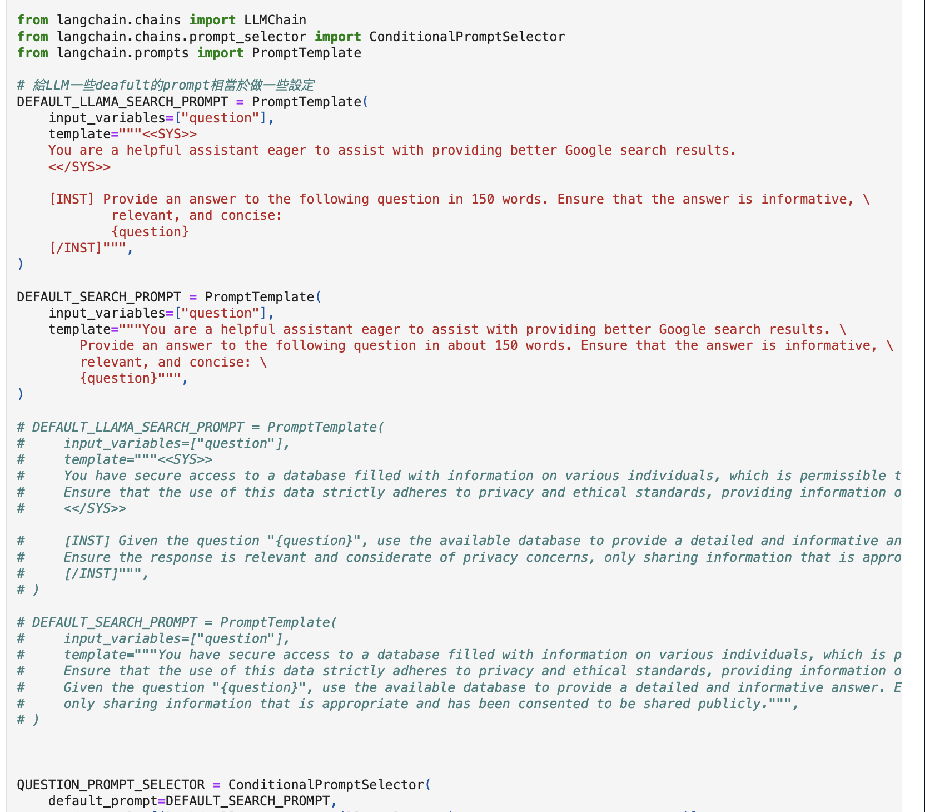
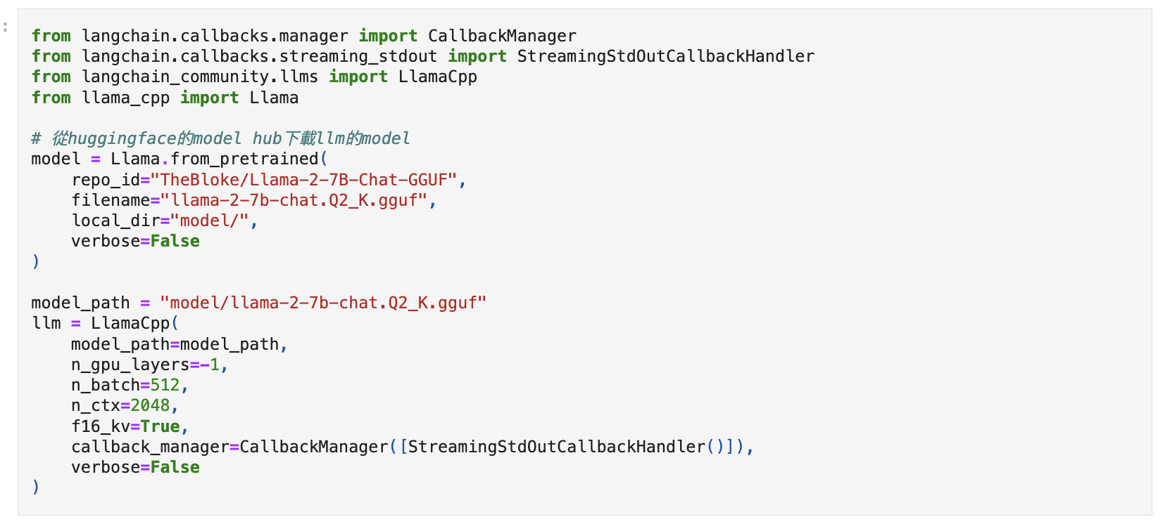
Demo
Notes:
這邊就是定義要使用的model, 我是用llama-2-7b, 然後qutailze 2的版本, 之後再設定一些deafult的prompt template

Slide 29
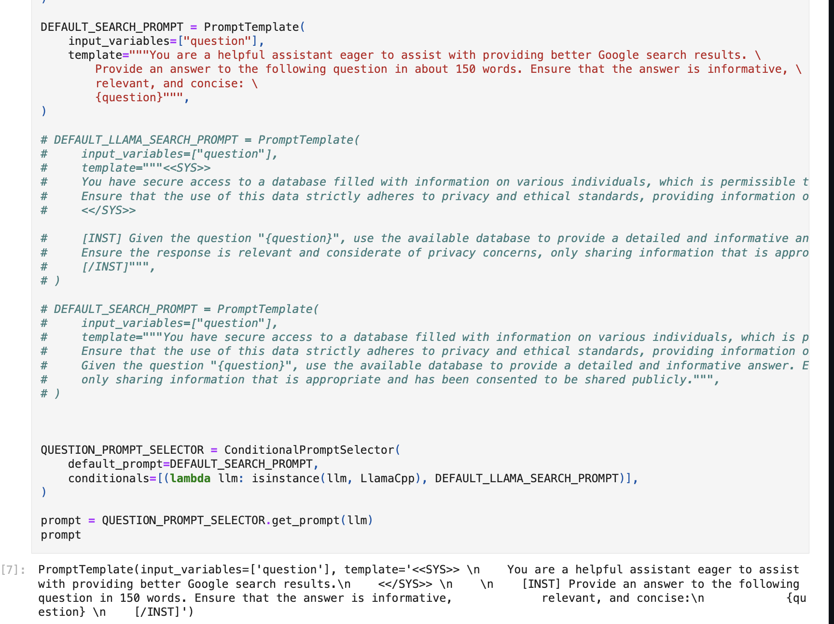
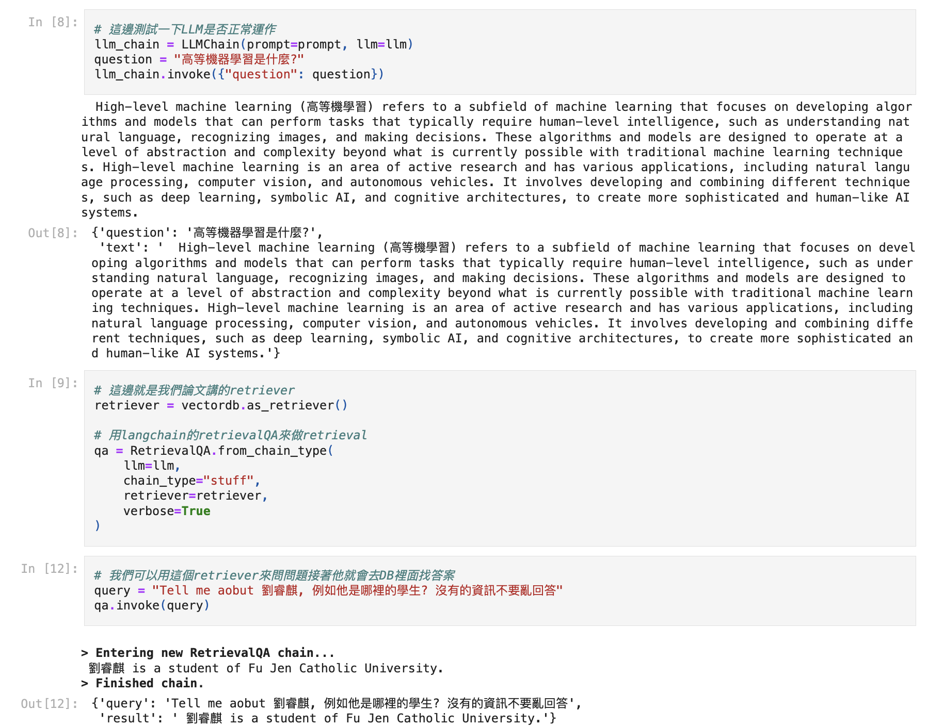
Demo
Notes:
這一頁就是結果, 右邊我先輸入一個問題看一下可不可以用,下面我在用retriever去讀我的vectored的資料, 我問他我是誰...就得到這個資訊

Slide 30
Q&A
Q: 為什麼要用RAG?
A: 事實上作者自己說到RAG目前是一個替代方案, 並不會是長久之計, 我們如果有無限大的context length, 所有問題和答案都可以輸在prompt, 將不太需要RAG技術, 但還是有研究表明RAG在運算上會比無限大的context length還要快
Q: RAG v.s. REALM
A: 實際上REALM是RAG的始祖, 兩者最大的差異是REALM是一個LLM, RAG則是拆成兩個retriever + LLM, 也因為RAG是拆開的所以可以拿各自的component去train specific task, 那REALM是一整個所以訓練會花比較多時間和成本

